Slide 1

CAREER ORIENTATION : AI DEVELOPER
NAME : VINEET SINGH
ROLL NO. : RU-25-11605

Slide 2

Becoming an AI Developer: Your Complete Guide
Artificial Intelligence is transforming every industry, from healthcare to entertainment, and AI developers are the architects of this revolution. This comprehensive guide will take you through everything you need to know about becoming an AI developer—from essential skills and common challenges to a detailed roadmap for success. Whether you're a beginner curious about the field or a developer looking to transition into AI, this presentation will equip you with the knowledge and direction to embark on this exciting career path.

Slide 3

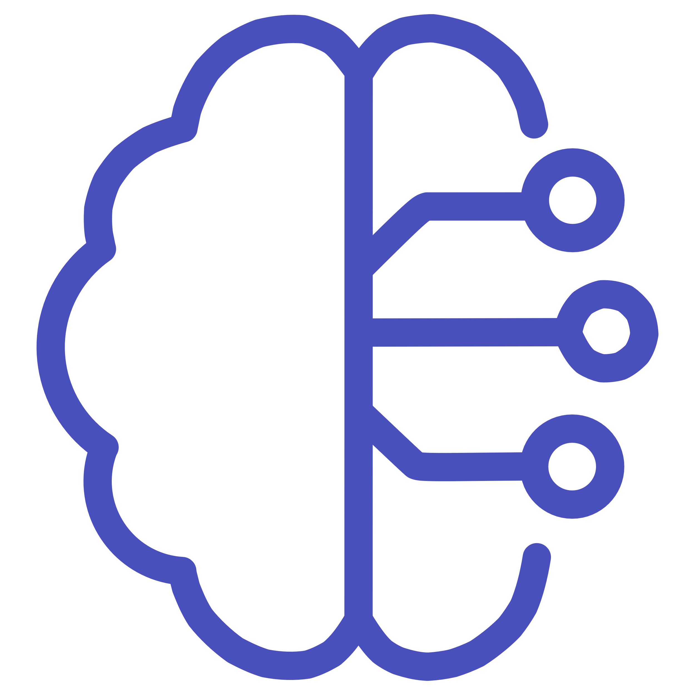



What is an AI Developer?
AI developers are the innovators who bring intelligent systems to life. They design, build, and deploy AI applications that solve complex real-world problems—from chatbots that understand natural language to recommendation engines that predict user preferences, and computer vision systems that can identify objects in images.
Build & Code
Create intelligent applications
Design Systems
These professionals leverage powerful programming languages like Python and Java, combined with cutting-edge AI frameworks such as TensorFlow and PyTorch. The role demands a unique blend of mathematical thinking, statistical analysis, and creative problem-solving to create systems that don't just follow instructions—they learn, adapt, and improve over time.
Architect learning algorithms
Collaborate
Work cross-functionally
Collaboration is central to the role. AI developers work alongside data scientists, software engineers, product managers, and business stakeholders, translating technical possibilities into practical solutions that drive business value and enhance user experiences.

Slide 4






Essential Knowledge & Skills for AI Developers
Success as an AI developer requires a diverse skill set that spans technical expertise, mathematical foundations, and interpersonal abilities. Here's what you need to master:
Programming Languages
Mathematics & Statistics
ML & Deep Learning
Master Python as your primary language—it's the industry standard for AI with extensive libraries and community support. Learn Java for enterprise applications and C++ for performance-critical systems where speed matters.
Build a strong foundation in linear algebra for understanding neural networks, probability and statistics for data analysis, and calculus for optimization algorithms. These are the mathematical pillars of AI.
Understand core algorithms, neural network architectures, Natural Language Processing for text analysis, and computer vision for image recognition. These are your AI building blocks.
Tools & Frameworks
Data Engineering
Soft Skills
Get hands-on with TensorFlow, Keras, PyTorch, and Scikit-learn for model development. Familiarize yourself with cloud platforms like AWS, Google Cloud, and Azure for scalable AI deployment.
Learn data preprocessing techniques, cleaning methods, feature engineering, and pipeline management. Quality data is the fuel that powers effective AI models.
Develop strong communication to explain complex concepts, teamwork for cross-functional collaboration, and maintain a continuous learning mindset to stay ahead in this rapidly evolving field.

Slide 5

Challenges AI Developers Face
The path of an AI developer is rewarding but filled with unique challenges. Understanding these obstacles prepares you to navigate them effectively:
Data Quality Issues
1
Dealing with noisy, incomplete, or biased datasets that can significantly affect model accuracy. Real-world data is messy—you'll spend significant time cleaning and validating it before training models.
2
Model Complexity
Finding the sweet spot between performance, interpretability, and computational cost. A model that's too complex may be accurate but impossible to explain; too simple and it won't capture important patterns.
Rapid Technological Evolution
3
Keeping pace with fast-changing AI research, emerging tools, and evolving best practices. New breakthroughs happen monthly, requiring constant learning and adaptation.
4
Deployment & Scalability
Moving models from development to production environments reliably and at scale. What works on your laptop must work for millions of users with consistent performance.
Ethical Concerns
5
Ensuring AI systems are fair, transparent, and privacy-compliant. You're responsible for building AI that doesn't discriminate and respects user data.

Slide 6

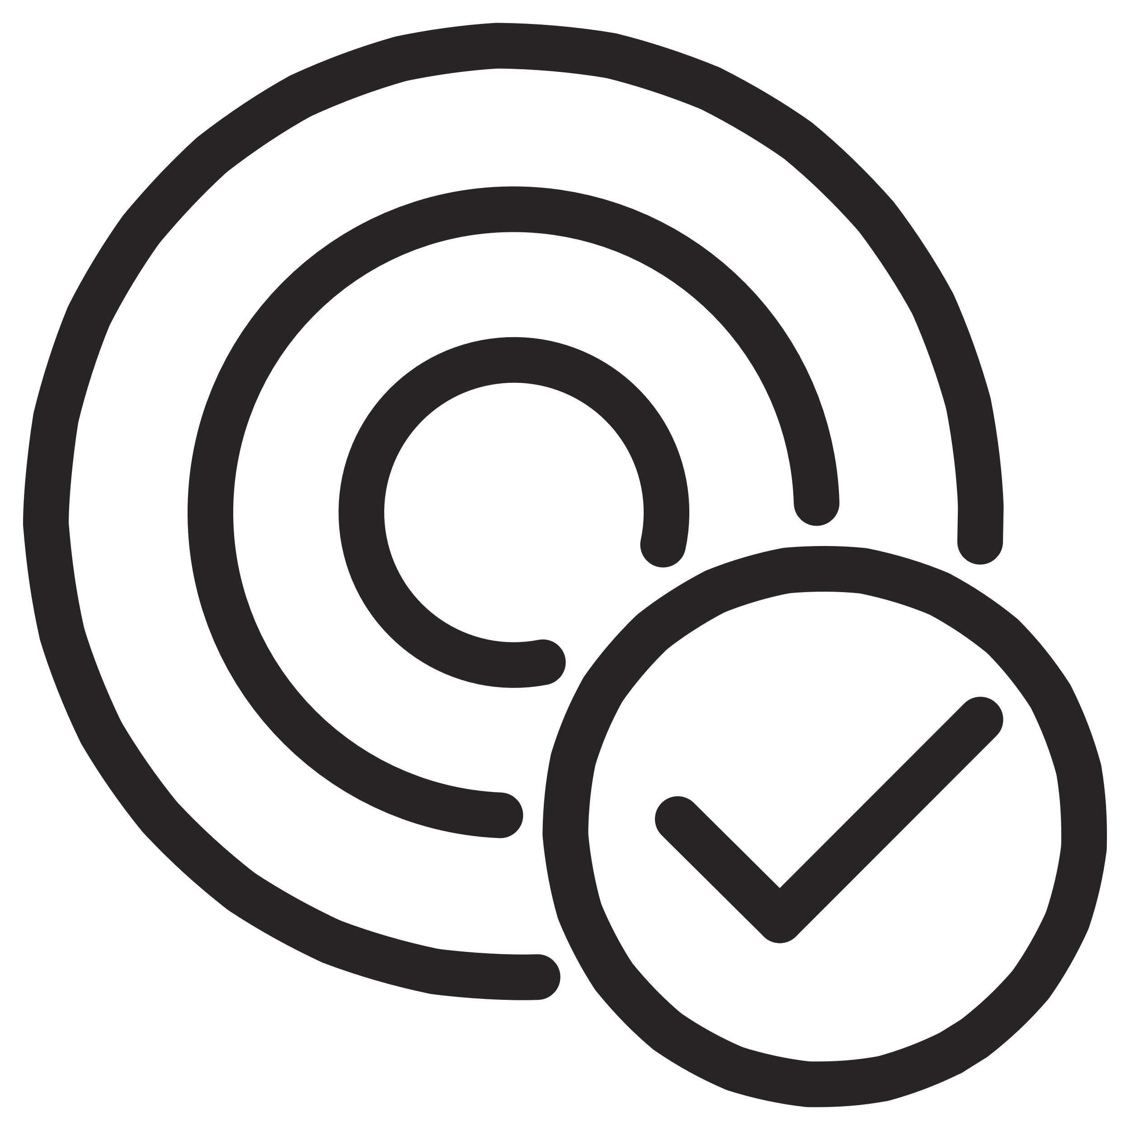





How to Level Up as an AI Developer
Continuous growth is essential in AI development. Here are proven strategies to accelerate your journey from beginner to expert:
Build Hands-On Projects
Specialize Strategically
Create real-world AI applications that solve actual problems. Build a recommendation system, chatbot, or image classifier. Your portfolio demonstrates practical skills to employers.
Focus on specific subfields like NLP, computer vision, or reinforcement learning. Deep expertise in one area makes you more valuable than broad surface knowledge.
Continuous Learning
Get Certified
Follow the latest research papers, tutorials, and open-source projects on GitHub. Subscribe to AI newsletters and watch conference talks to stay current.
Earn recognized AI certifications from platforms like Coursera, Google, or AWS. Certifications validate your skills and enhance your credibility with employers.
Join Communities
Collaborate Widely
Engage with AI forums, Kaggle competitions, and developer groups. Learn from others, get feedback on your work, and stay motivated through peer connections.
Work with cross-functional teams including designers, product managers, and business analysts. Diverse experience makes you a well-rounded developer.

Slide 7








Roadmap to Becoming an AI Developer
Follow this structured path to transform from beginner to job-ready AI developer. Each phase builds upon the previous, creating a solid foundation for your career:
Learn Programming & Math Foundations
Timeline: 3 months | Master Python and Java basics. Build strong foundations in linear algebra, probability, statistics, and calculus. These are your essential tools.
Master Core AI Concepts
Timeline: 3 months | Study machine learning algorithms, deep learning architectures, NLP techniques, and computer vision fundamentals. Take structured courses and complete exercises.
Gain Practical Experience
Timeline: Ongoing | Build projects using TensorFlow and PyTorch. Participate in Kaggle competitions. Apply your knowledge to real datasets and problems.
Learn Deployment & Cloud Tools
Timeline: 2 months | Master Docker for containerization, Flask for API development, and AWS or Google Cloud Platform for scalable model deployment.
Build Portfolio & Network
Timeline: Ongoing | Showcase your best projects on GitHub with clear documentation. Connect with AI professionals on LinkedIn. Attend meetups and conferences.
Apply for AI Developer Roles
Timeline: When ready | Target internships and junior positions. Prepare for technical interviews. Keep learning and growing throughout your career.
"AI development is a journey of constant learning and innovation—start building today to shape tomorrow."

